Slide 1
Mini project
Personalised GLA Assistant
Under the guidance of – Submitted by- mr. amir khan Prakhar srivastav(161500391)
kushagra mishra(161500294 )
subrat mishra(161500567)
kumar Ujjwal pandey(161500290)
Govind Chaudhary(161500218)

Slide 2
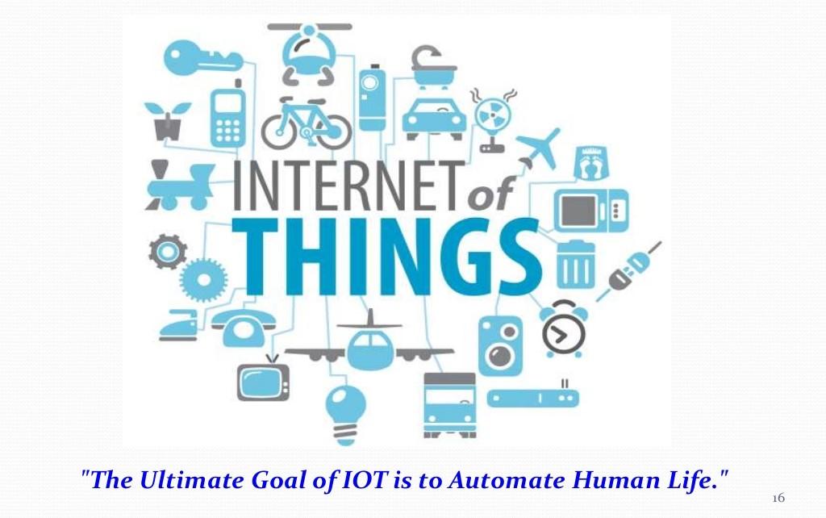

Slide 3
OUR PROJECT:
It is a GLA assistant bot.
It can also be used in home automation.
It can be used as a personal assistant.

Slide 4
Our project provides a better alternative than the assistants which are available in the market, we have also customised in accordance with GLA University .Not only it solves the primitive queries but also it can answer questions related to GLA University .It is customizable and can be personalised as per one’s need.
It can be used as GLA assistant which can guide new comers

Slide 5
Since it has no Graphical User Interface , so the queries which can not be handled using only speech output it also provides the graphical output to the phone , like when user asks for directions from point A to point B it not only tells you the directions but also sends you the directions in your phone’s map .

Slide 6
PROS
It is cost effective ,while other such assistant costs eight to ten thousand ,it cost only three thousand
Portable
Multi platform support :while other assistant such as Google uses only Google services and Amazon Alexa uses only Amazon services our product can be combined with both hence it provides better results

Slide 7
Future scope
It can be used at GLA main gate which will solve questions related to GLA University.
It will also help in home automation
It can be a better alternative to similar products available in the market
It can be used at stations , hospitals and public places

Slide 8
Scope
HOSPITAL
INDUSTRY
FACTORIES
OFFICES
SCHOOL/
COLLEGE

Slide 9

Our approach
IOT technology has been used to achieve our goal. We have used Raspberry Pi 3 ,mic and speaker

Slide 10
As GLA University’s assistant :
Other assistant can not handle specific querries related to GLA university but our product can handle those queries very well . Like, for example when one asks “tell me about GLA University” following is the kind of response user can get from the assistant:
GLA University is 3rd best private university in Northern India approved by the AICTE located in Mathura Uttar Pradesh. It has been accredited with Grade ‘A’ by NAAC.

Slide 11
Home Automation :
It can also be used to automate various home appliances such as “turning on/off the lights, fans, Ac etc.

Slide 12


